Slide 1

Health Care Price Transparency

Slide 2

Charles Miller,
Senior Policy Advisor

Slide 3






What Flavors of Price Transparency And Who Benefits?
All Payer
Claims Database
Hospital Prices
Insurer Rules
APCD
Hospital Prices
Insurer Rules
Large Employers
Researchers & Policymakers
Large Employers
Benefit Design
Consumers
Researchers
& Policymakers
Consumers
Notes:
Three areas where price transparency should be improving. A lot of focus has been on whether consumers will or can use the data, but that’s only part of it.
We see the primary beneficiary of each type of policy
But, all of these policies work well and interact with each other.

Slide 4

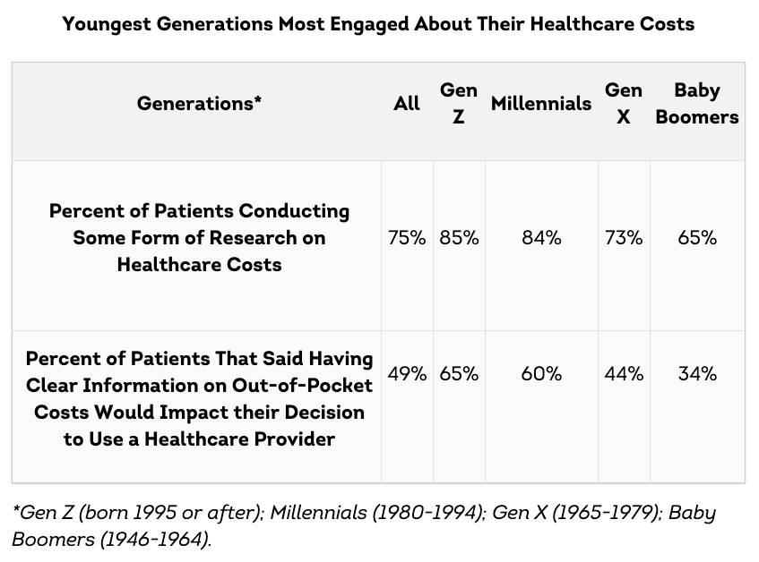

Comparison Shopping is Generational
https://newsroom.transunion.com/news-reports-about-a-weakening-economy--impacting-how-some-patients-seek-medical-treatment/
This Photo by Unknown Author is licensed under CC BY-NC-ND
Notes:
We can also see that younger generations are much more likely to use this information to impact their shopping behavior.
- 1/3 of Texans, and 57% of Texas mothers, said that they skipped care because they didn’t know what the price would be.

Slide 5
Health Care Price Transparency
Key Dates – Federal and Texas
Hospital Price Transparency
1/1/21 | Federal Price Transparency Rules Took Effect | Federal
7/19/21 | CMS Proposed Increased Penalties for Non-Compliance | Federal
9/1/21 | Texas Law (SB 1137) Took Effect | Texas
1/1/22 | CMS Rules with Increased Penalty for Non-Compliance Take Effect | Federal
2/26/23 | Texas Rules Clarifying the Enhanced Penalties in Texas Statute | Texas
Insurer Price Transparency
1/1/22 | Federal Rules & Texas Law (HB 2090) for Machine-Readable Files Take Effect | Federal & Texas
7/1/22 | Federal Rules for Machine-Readable Files delayed enforcement date | Federal
1/1/23 | Federal Rules for Consumer Comparison Tool for 500 Services Take Effect | Federal
1/1/24 | Federal Rules and Texas Law for All Services Takes Effect | Federal & Texas
Notes:
Walk through the timeline.
-Note especially the different flavors of insurer transparency that will be released.
-TDI is already talking about delaying enforcement to 180 days from rule effective date

Slide 6
Transparency Compliance

Slide 7
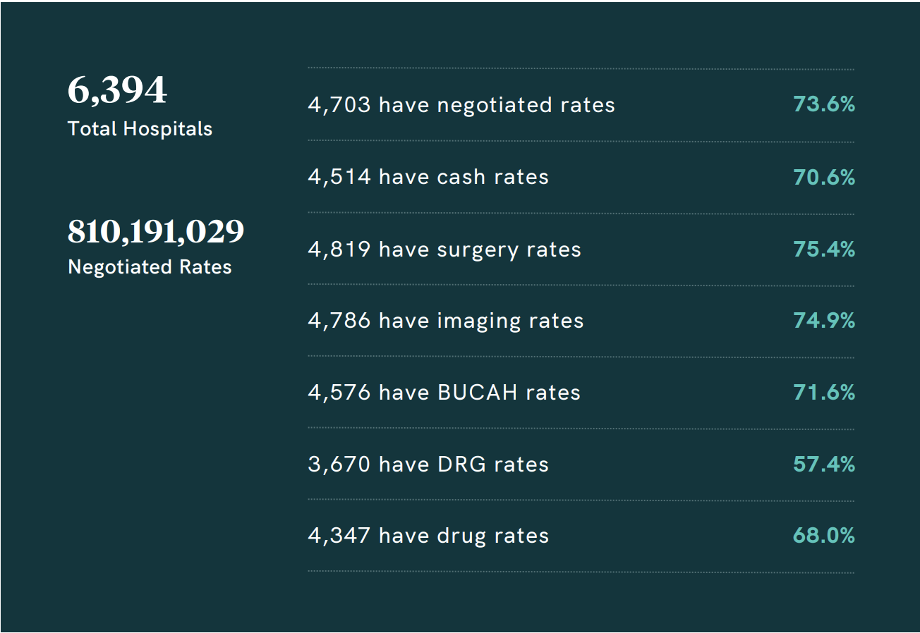
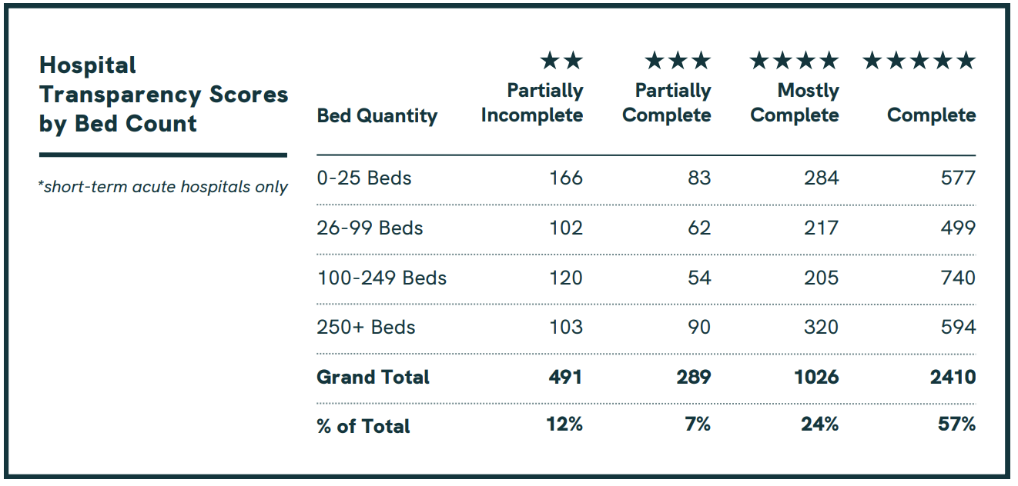
Hospital Compliance - National
By Bed Size
By Service Type
Source: Turquoise Health Price Transparency Impact Report: Q1 2023.
Notes:
-Very early and incomplete data
-”Full compliance” doesn’t necessarily mean useful information

Slide 8

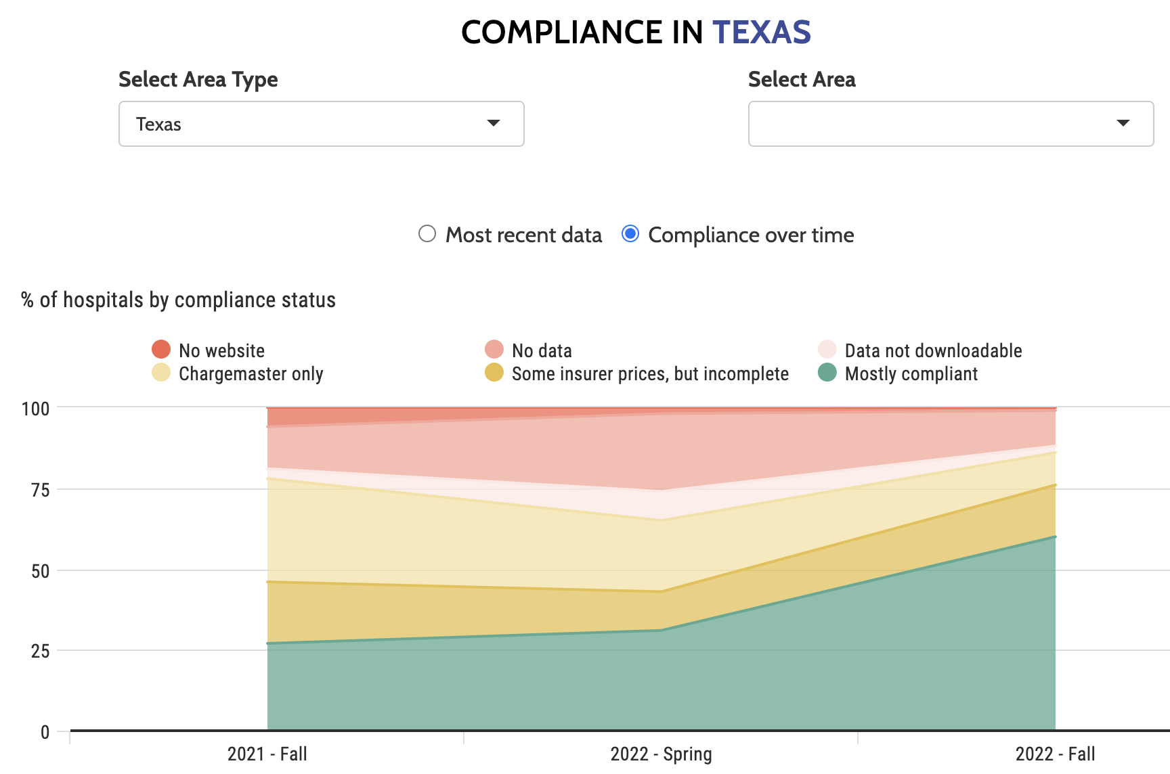
Hospital Compliance - TX
Incomplete / Partial Data (~200 / >641 hospitals)
Notes:
-Very early and incomplete data
-”Full compliance” doesn’t necessarily mean useful information

Slide 9
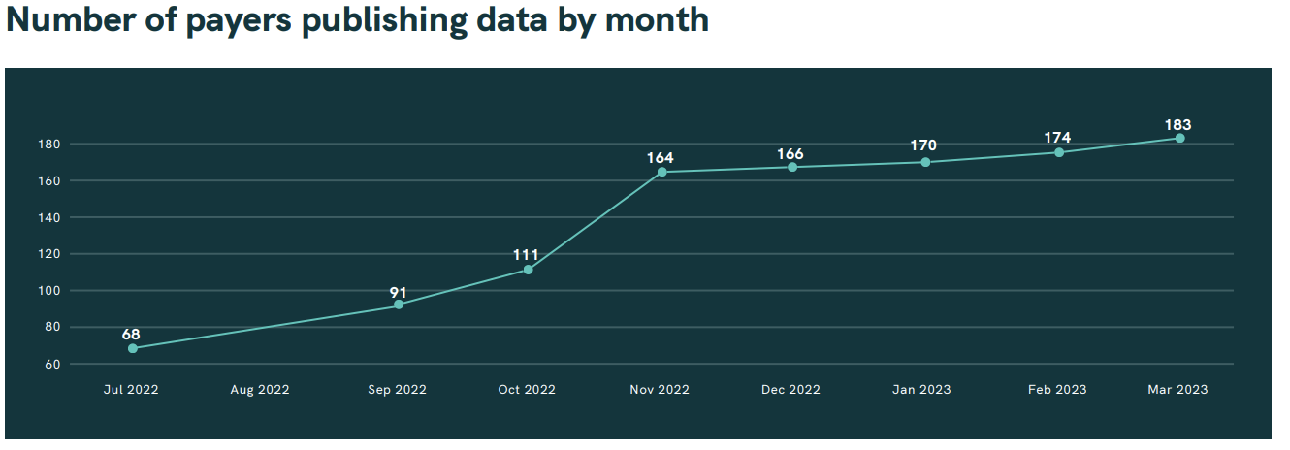
Payer Compliance – Over Time
Source: Turquoise Health Price Transparency Impact Report: Q1 2023.
Notes:
-Very early and incomplete data
-”Full compliance” doesn’t necessarily mean useful information

Slide 10
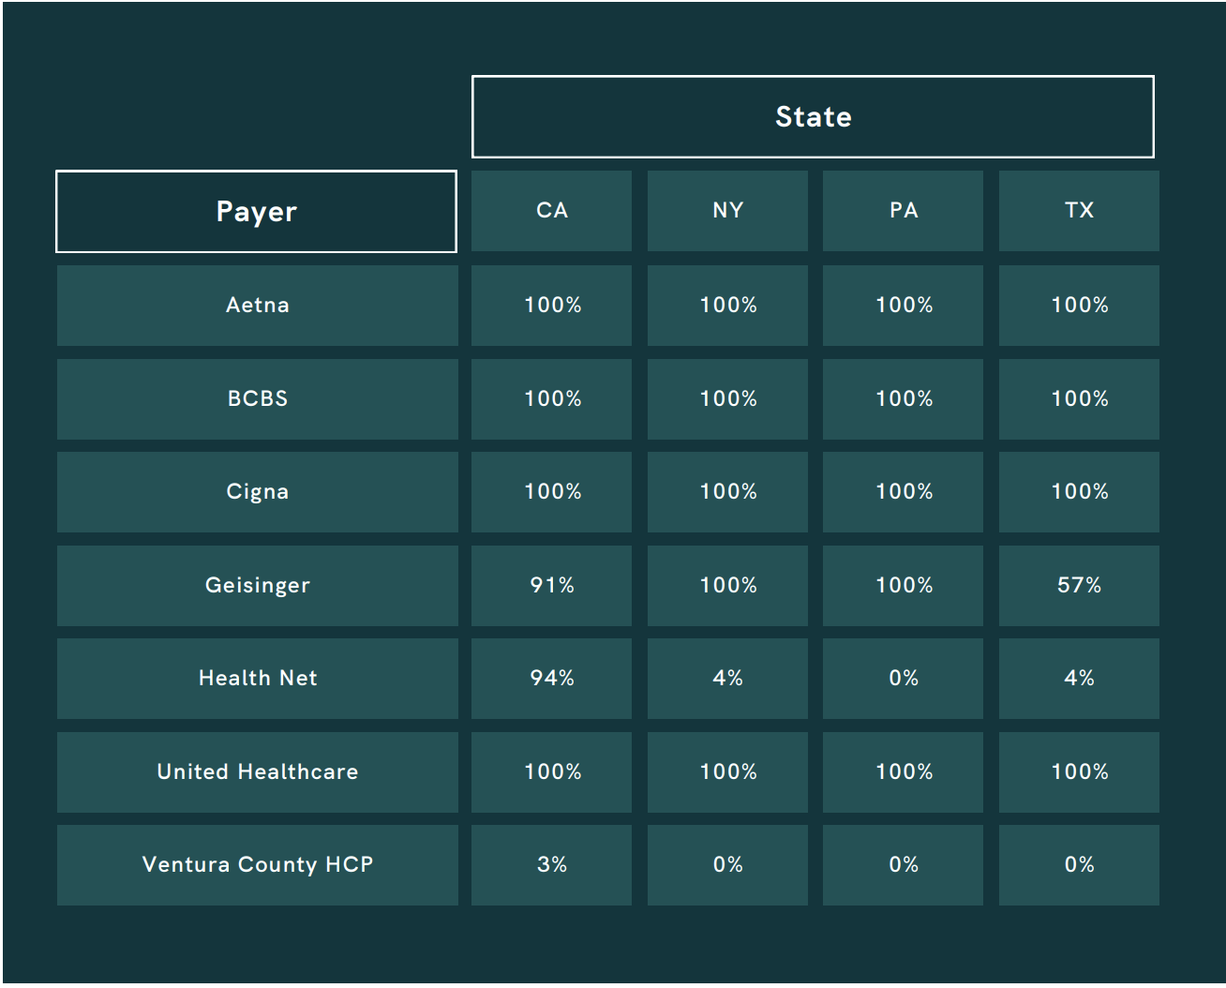
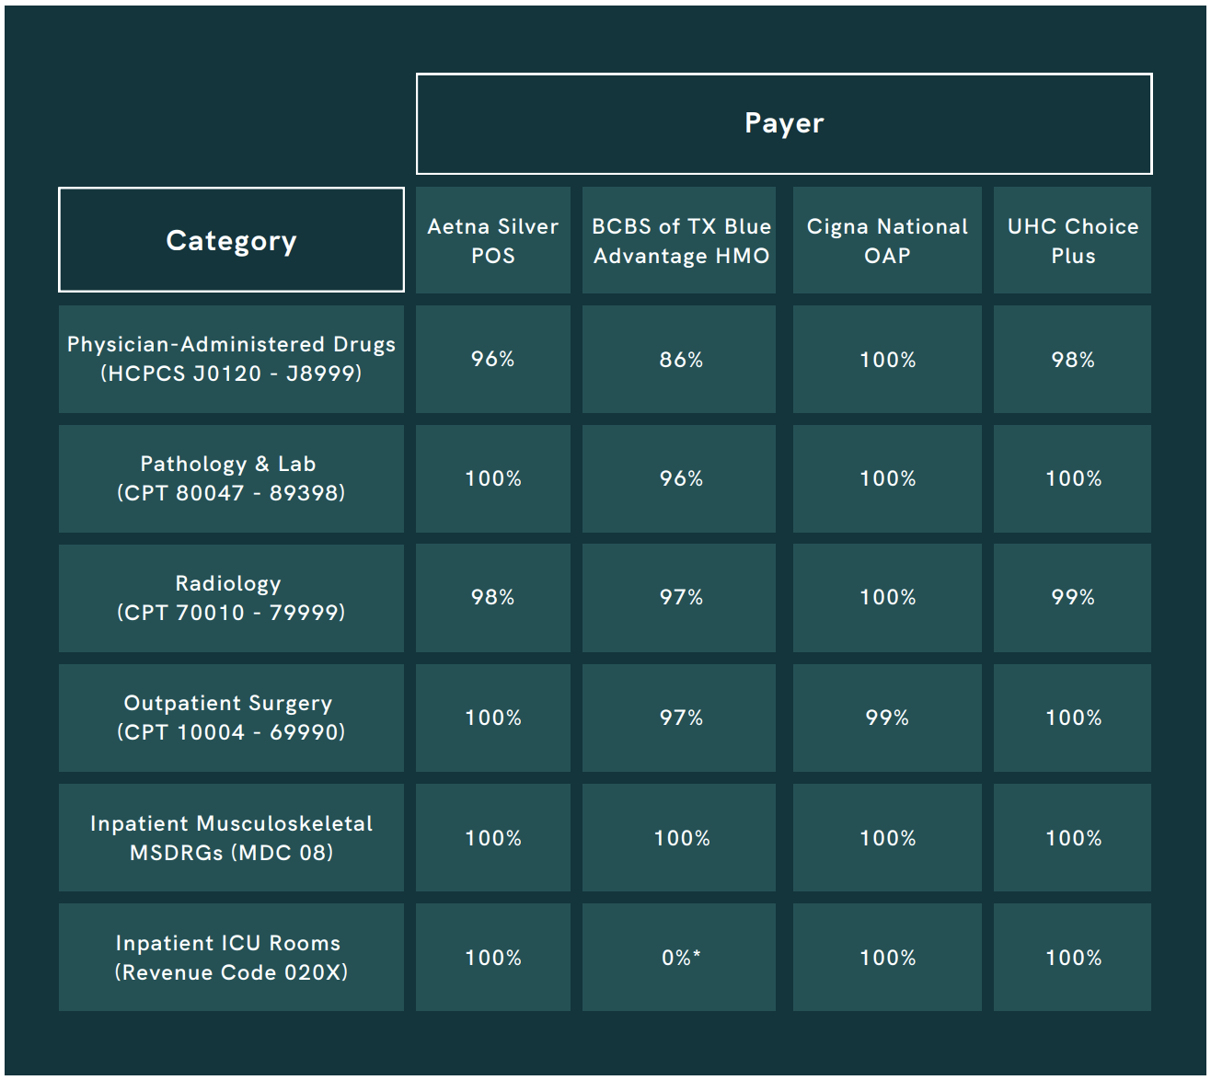
Payer Compliance – Local & Service
Source: Turquoise Health Price Transparency Impact Report: Q1 2023.
Notes:
-Very early and incomplete data
-”Full compliance” doesn’t necessarily mean useful information

Slide 11
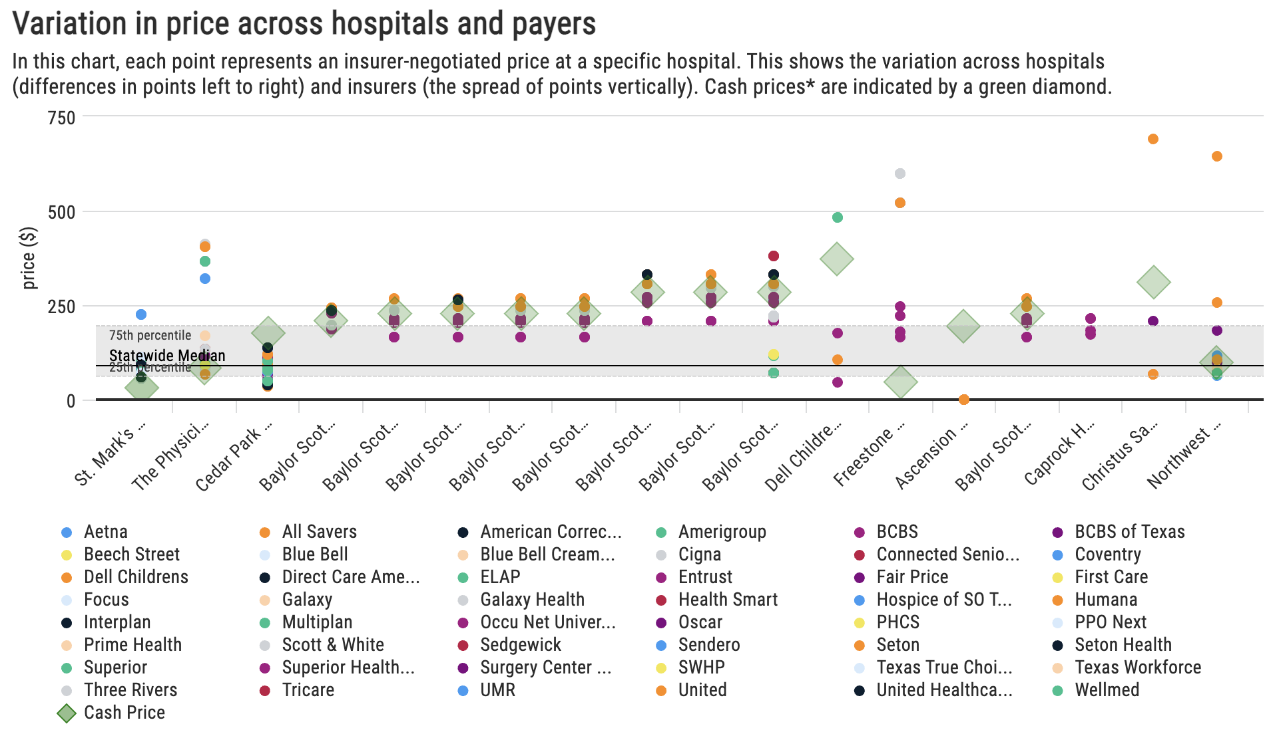
Prices?
ER Visit: Level 1
Central Texas Area
Notes:
-Very early and incomplete data
-”Full compliance” doesn’t necessarily mean useful information

Slide 12
Questions?
Contact Charles: charles.miller@gmail.com charles.miller@texas2036.org
Twitter: @CharlesTXPolicy pricetransparency.texas2036.org

