Slide 1
SETTING THE STAGE
Hope Osborn Manager, Policy & Advocacy
hope.osborn@texas2036.org
Official Data Partner of Texas Lyceum
Notes:
Good Morning.
I am thrilled to be here to set the stage with data and facts for the robust conversations about sustainability of Texas communities west of I-35 that are planned for the remainder of today.
Before I begin, I’d like to thank Texas Lyceum president Sarah Jackson and Tam Hawkins for appointing us as the official data partner of the Texas Lyceum.
And I’d also like to thank this conference’s co-chairs — Kristina Butts, Josh Winegarner and Nathaniel Wright — for putting together such an important conference.

Slide 2
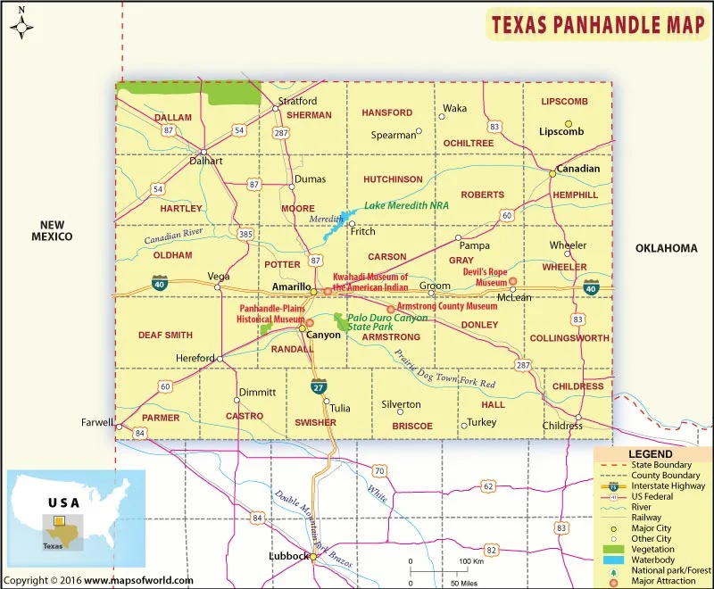
The Texas Panhandle covers 25,610 square miles and includes 26 counties.
Notes:
So, to begin, let’s start with the Texas Panhandle and its size.
Slightly larger than the state of West Virginia, the nearly 26,000-square-mile Panhandle includes the northernmost 26 counties of the state, and borders New Mexico on the west and Oklahoma on the north and east.
With a population of around 435,000, about 60% of folks in the Panhandle reside in the centrally located Amarillo Metro Area, while most other communities have a population below 4,000 people.
The Panhandle is a product of the Compromise of 1850 following the Mexican War, which resolved the state’s dispute of territorial claims with New Mexico. The 26 Panhandle counties were officially declared in 1876 by the Texas legislature.
SOURCES:
https://statesymbolsusa.org/symbol-official-item/national-us/uncategorized/states-size
https://www.tshaonline.org/handbook/entries/panhandle
Panhandle Regional Planning Commission’s Texas Panhandle Comprehensive Economic Development Strategy, Aug. 26, 2021, Report

Slide 3
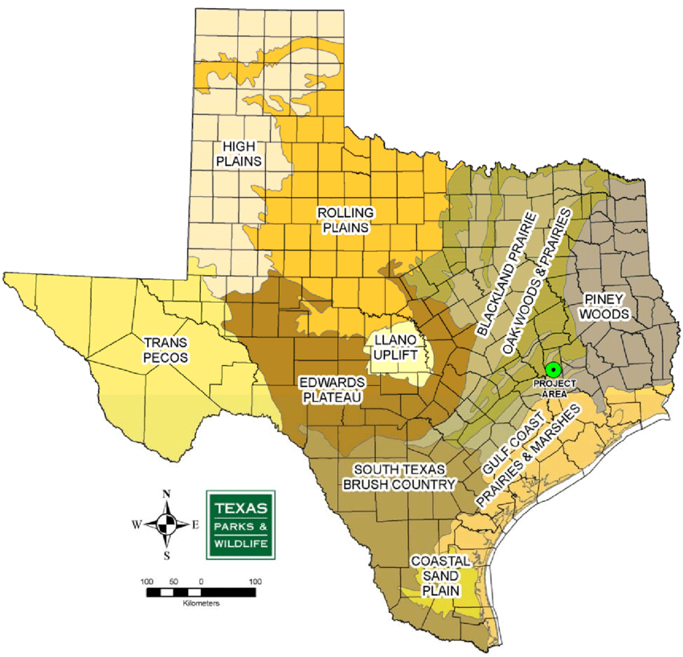
The Texas Panhandle is shaped by its geography, which includes the arid high plains and rolling plains.
Notes:
The Panhandle, also referred to as the High Plains, is part of the Great Plains that extends throughout the Central United States.
You may also hear the area referred to as Llano Estacado (La-now Eh-stuh-kaa-dow), which is thought to mean “staked” or “palisaded” plains.
The area is a vast, mostly flat, grassland.
However, the eastern part of the side, known as the Rolling Plains, is not as flat and has more brush given its additional rainfall.
The Panhandle is also home to Palo Duro Canyon and Caprock Canyons State Parks. These deep canyons carved by rivers split the western and eastern parts.
And the semi-arid region is prime for animals dependent on grasses and built to live where water is less common, including the once almost extinct bison, prairie dogs, rattlesnakes and the tiny Palo Duro mouse.
SOURCES:
https://tpwd.texas.gov/education/resources/texas-junior-naturalists/regions/panhandle-plains
https://www.texasstandard.org/stories/el-llano-estacado-the-vast-staked-palisaded-plain/
https://tpwd.texas.gov/education/resources/texas-junior-naturalists/regions/panhandle-plains/panhandle-plains-wildlife

Slide 4
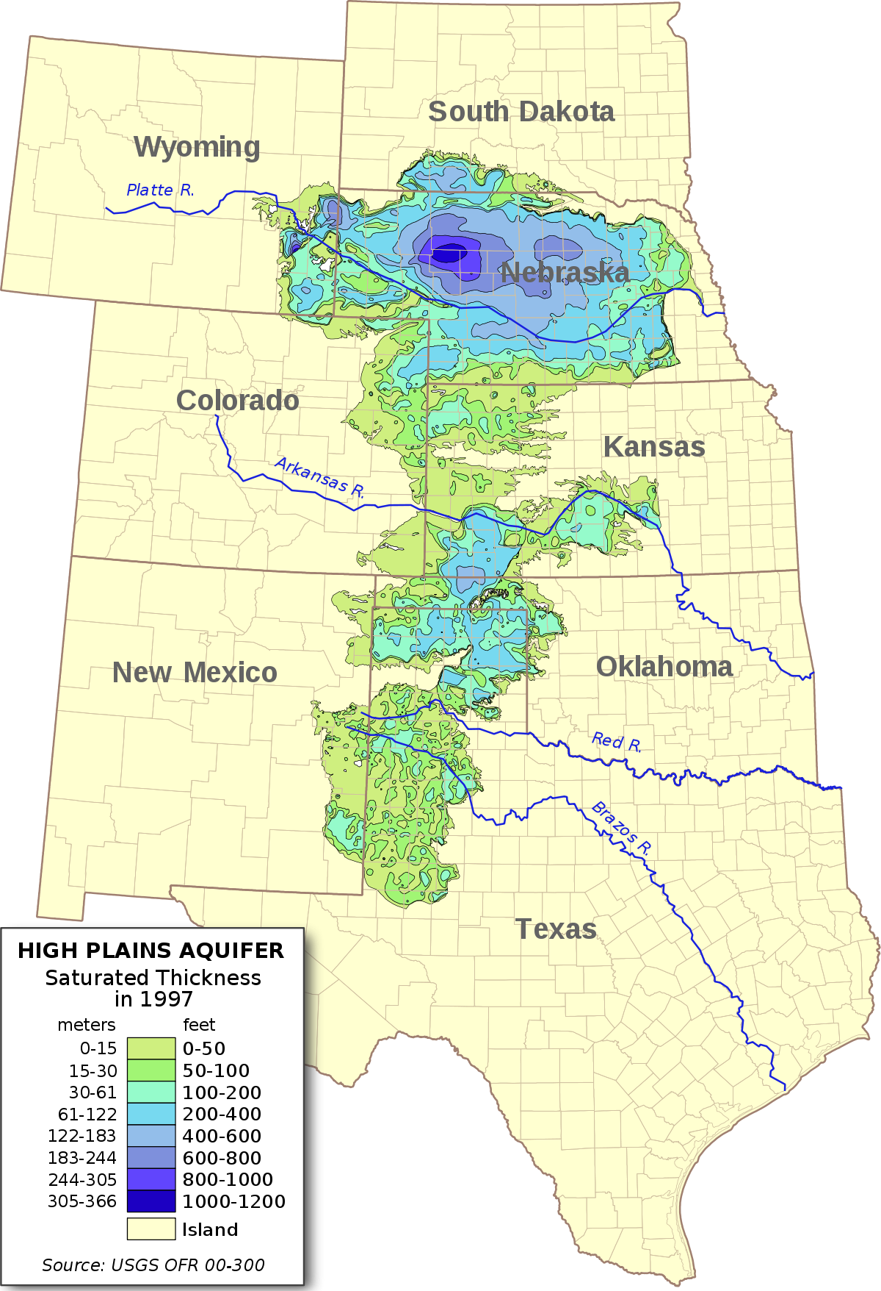
Water is the lifeline for the region’s expansive agriculture industry.
Notes:
But not all inhabitants can manage with such little water.
Lying under multiple states, beneath the Great Plains, the Ogallala (oh-guh-LAH-lah) Aquifer is one of the world's largest aquifers expanding an area of approximately 174,000 square miles.
As the primary water source for millions of people, in the Panhandle, it’s the area’s most valuable water resource.
According to Texas Parks & Wildlife, nearly all — 97% — of this area’s water needs are dependent upon the aquifer. And approximately 90% of the water demand is for irrigation of which agriculture in Texas and thus the nation depend.
But the aquifer is at risk from increasing drought conditions and water being pumped faster than it can recharge. At current rates of usage, the Ogallala may see a 70% decrease in water levels by 2080.
The Ogallala’s depletion plays a persistent challenge for the Texas Panhandle’s economy.
SOURCES:
https://www.usgs.gov/news/technical-announcement/usgs-high-plains-aquifer-groundwater-levels-continue-decline#:~:text=The%20High%20Plains%20aquifer%2C%20also,South%20Dakota%2C%20Texas%20and%20Wyoming
https://tpwd.texas.gov/landwater/water/environconcerns/regions/panhandle.phtml#:~:text=The%20Ogallala%20Aquifer%20lies%20under,faster%20than%20it%20can%20recharge
https://www.kxan.com/texas-water/why-great-plains-agriculture-is-particularly-vulnerable-to-drought/

Slide 5
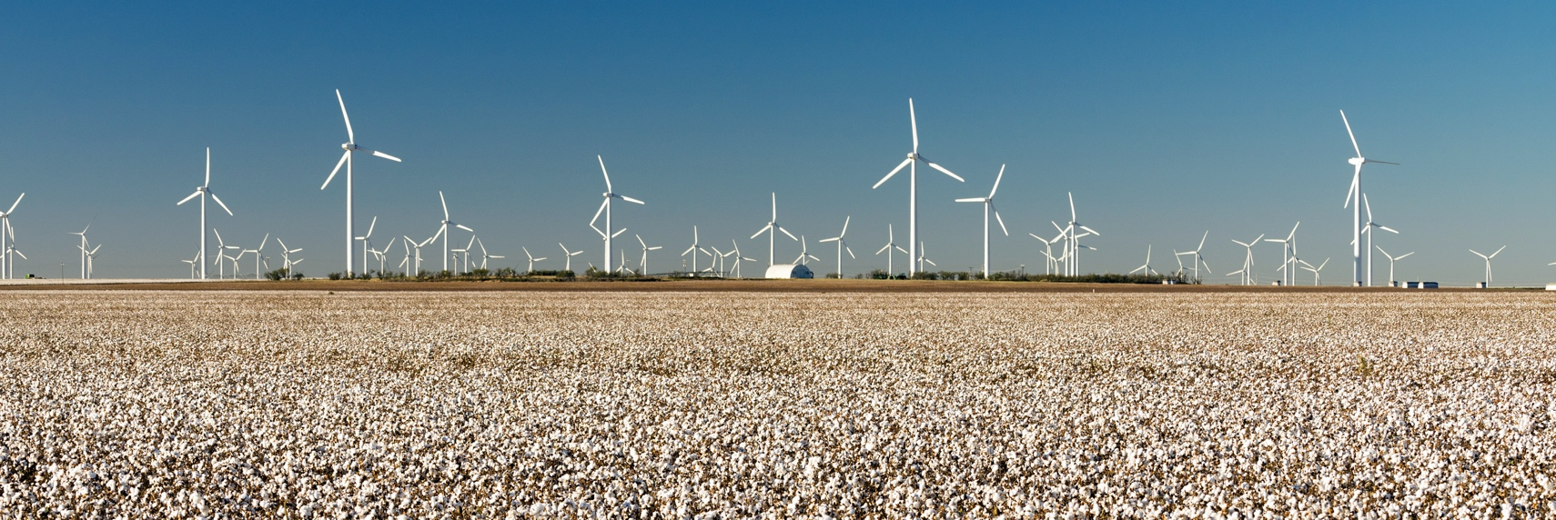
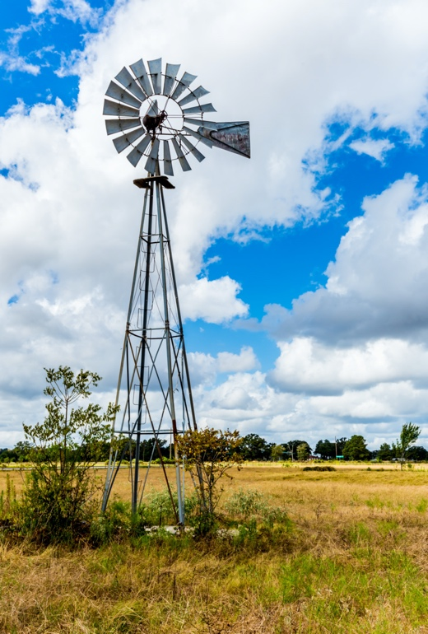
The economic engine of the region feeds and powers Texas and beyond.
Notes:
Starting with the region’s rich ranching heritage, the Panhandle’s economy has primarily been bound to agriculture, energy and the defense industry:
The Panhandle remains a top producer of fed beef, cotton and sorghum, as well as dairy, corn and wheat.
Yesteryear’s oil boom of the 1920s and 1930s is coupled with today’s energy expansion of renewables. In 2000, there were no wind turbines in the Panhandle, but that number shot up to about 2,400 in 2021.
And the defense industry has been one of the main sources of skilled and well-paying jobs in the Panhandle, driving in talent from outside of the region for a specialized skillset required.
Specific to the Amarillo metro area, as you can also see on your handouts, the defense and security sector grew rapidly with an18% change in employment from 2010 to 2017. Likewise, energy and mining was among the fastest-growing sectors for Amarillo in that period with an employment increase of 24%.
SOURCE:
Texas Panhandle Comprehensive Economic Development Strategy report; Aug. 2021
https://www.dallasfed.org/research/heart/Amarillo

Slide 6
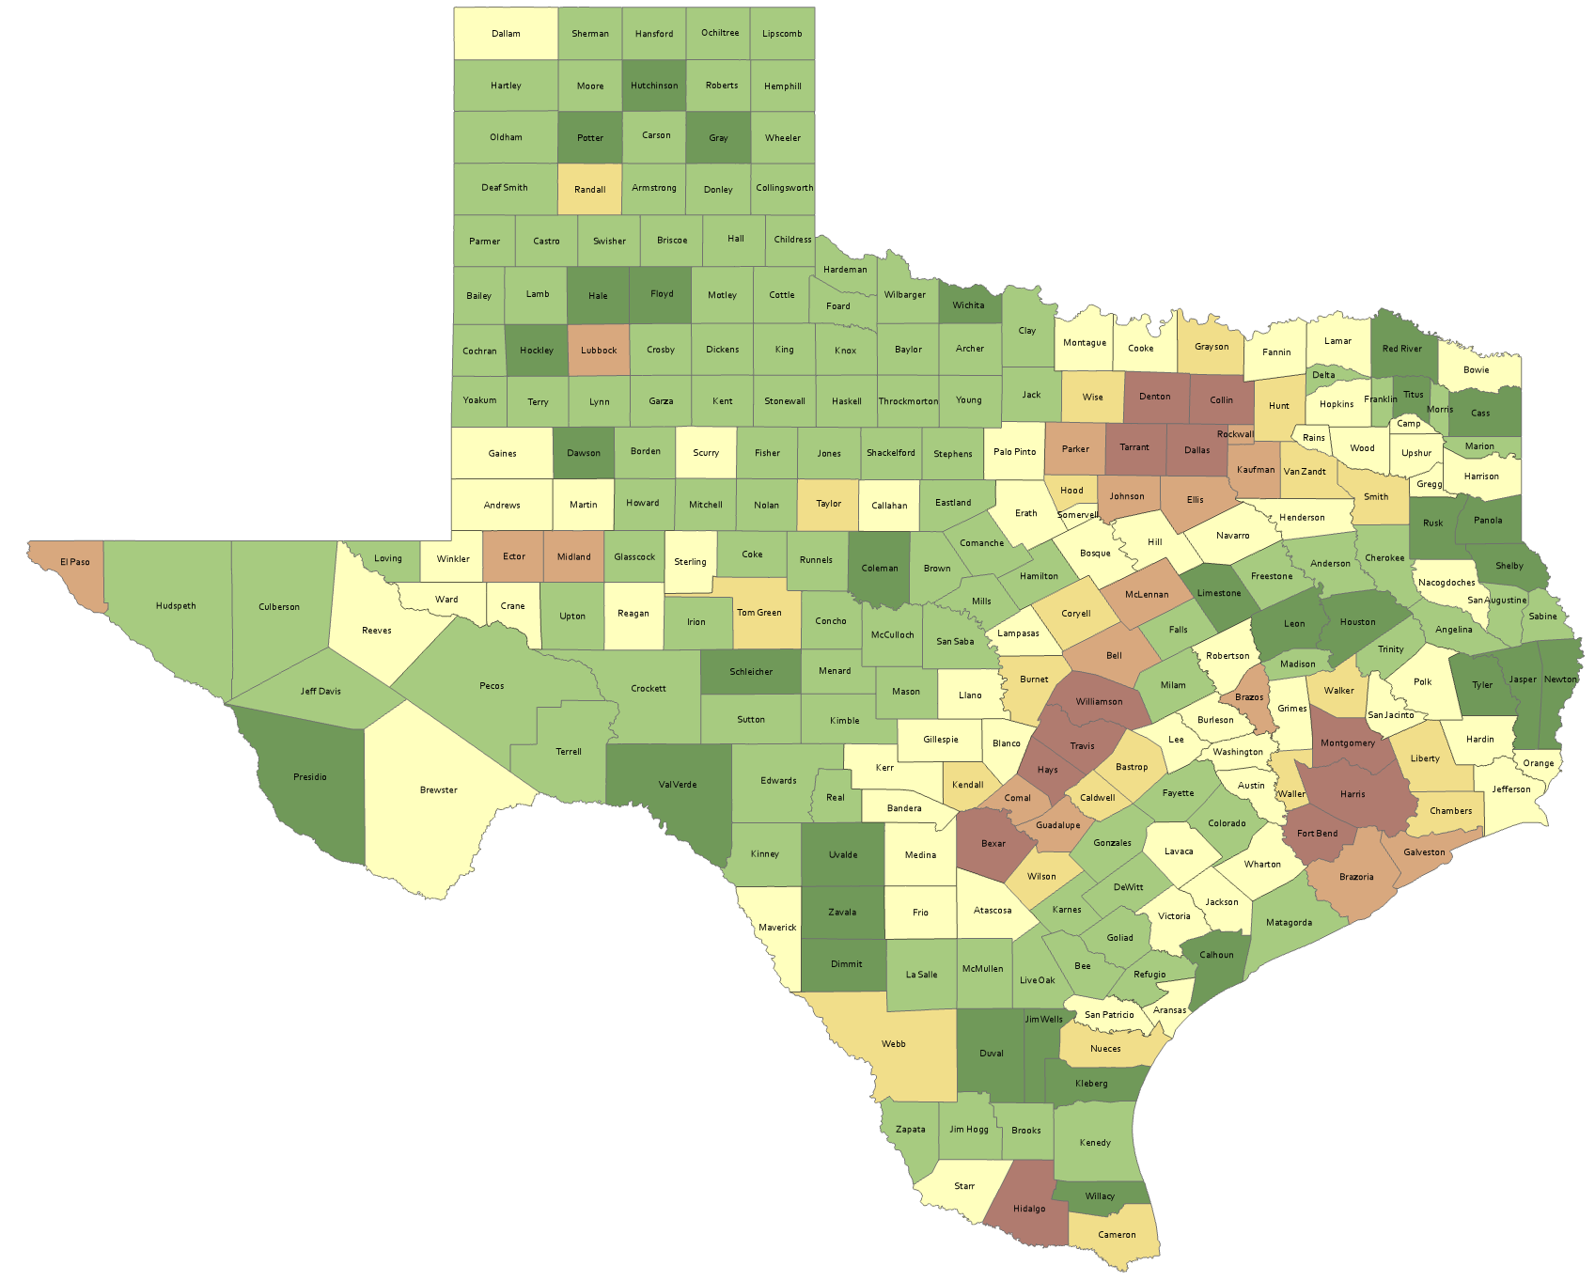
Numeric Change, Texas Counties, 2010-2020
The population of the Panhandle continues to evolve.
Total Population Change 2010-2020
-3,751 - -1,000
143
counties
lost population
-999 - 0
SOURCE: US Census Bureau, 2010 and 2020 Census, P.L. 94-171 Redistricting Files
1 – 5,000
5,001 – 25,000
25,001 – 75,000
75,001 – 638,686
Notes:
It’s these natural characteristics and economic opportunities that have led people to the Panhandle.
Although the Panhandle region accounts for 10% of the land in Texas, the population only represented 1.51% of the State in 2020, according to the Texas Demographic Center.
However, the massive migration to Texas that we hear about in the news isn’t distributed evenly across the state as you can see here with shades of green indicating decreasing population. The Census count from the last decade shows 24 of the 26 counties in the Panhandle decreasing in population.
SOURCES:
Texas Panhandle Comprehensive Economic Development Strategy, Aug. 26, 2021, Report
Shifting Demographics in Texas and the Amarillo Area, Texas Demographic Center, May 2021

Slide 7
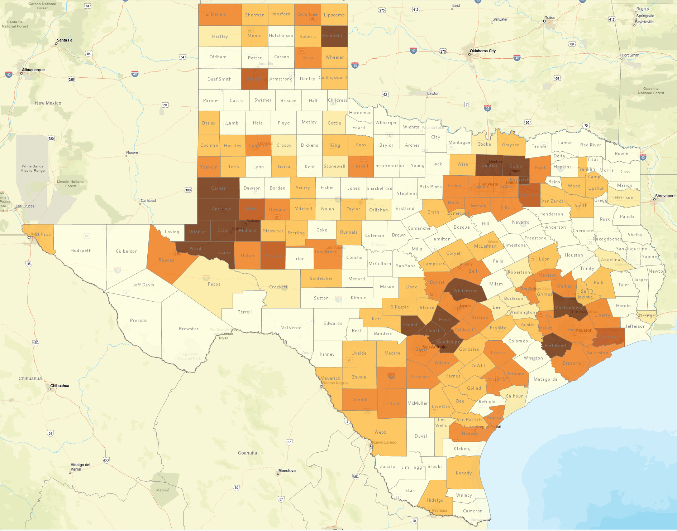
Projected Percent Population Change, Texas Counties, 2020-2050
Projected Percent Change 2020-2050
0 or less
0-5%
5.1-25%
And it’s
changing the Texas landscape.
25.1-75%
75.1-100%
100.1-350%
SOURCE: Texas Demographic Center, 2018 Population Projections
Notes:
But the region is growing in parts. For example, Randall, where Amarillo extends into, is projected to see 100,000 more people by 2050.
With these changes in growth also come changes in the people who call the area home.
SOURCES:
Texas Panhandle Comprehensive Economic Development Strategy, Aug. 26, 2021, Report
Shifting Demographics in Texas and the Amarillo Area, Texas Demographic Center, May 2021

Slide 8
Percent distribution of race/ethnic groups in Texas and select counties, 2016-2020
100%
41.2%
70.0%
43.2%
90%
Who are the people?
80%
70%
White alone, not Hispanic or Latino
60%
Hispanic or Latino
39.7%
39.1%
Two or More Races
50%
Asian
40%
American Indian and Alaska Native
30%
23.1%
Black or African American
20%
5.2%
5.8%
10%
12.9%
11.1%
0%
1.8%
SOURCE: US Census Bureau, 2010 and 2020 Census, P.L. 94-171 Redistricting Files
3.5%
Texas
Randall
Potter
Notes:
Here’s a breakdown of the largest concentration of folks in the Panhandle by race/ethnic groups from the latter half of the last decade.
Randall and Potter counties, where most of Amarillo metropolitan lies, offer an interesting perspective to what two neighboring communities look like.
Looking at just Amarillo, it is on par with the rest of the state in several ways: One in every four people is under the age of 18, nearly one in five people under the age of 65 is without health insurance and about 15% of the population is in poverty. When we zoom out and look at the more rural communities these numbers shift away from the state percentages, including educational attainment and access to broadband, among other things.
SOURCES:
Shifting Demographics in Texas and the Amarillo Area, Texas Demographic Center, May 2021
https://www.census.gov/quickfacts/fact/table/randallcountytexas,pottercountytexas,amarillocitytexas

Slide 9
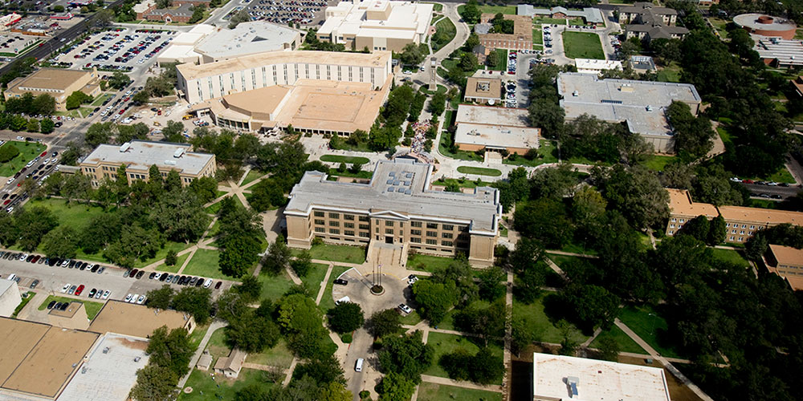
Investing in our own: Education in the Panhandle.
Notes:
But we know investment in all Texans is crucial to the success of the region and the state.
Only about 20% of the Panhandle population has completed post-secondary education with only one in three having some college courses under their belt.
The Panhandle Workforce Development Board is working with area community colleges and high schools to provide more certifications and training to develop a workforce ready for a more diversified economy.
For those seeking education beyond that, West Texas A&M University is close by, just south of Amarillo.
SOURCE:
Texas Panhandle Comprehensive Economic Development Strategy, Aug. 26, 2021, Report

Slide 10
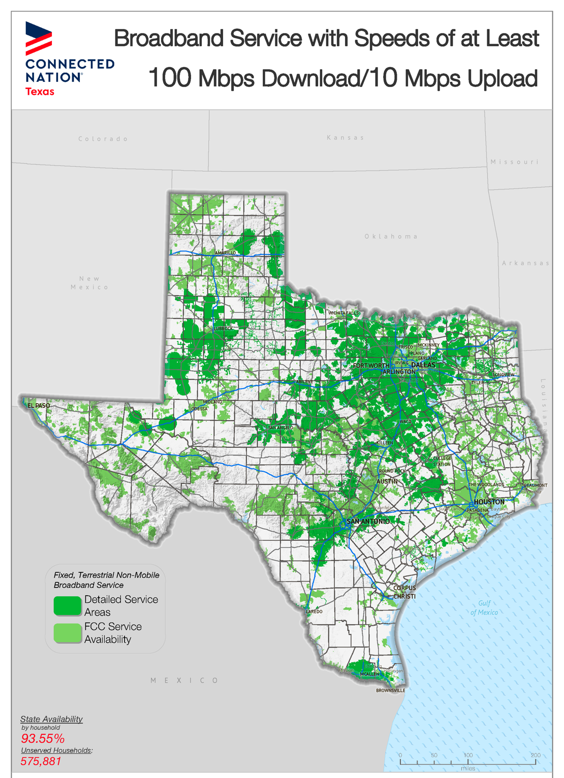
Broadband:
Keeping our community connected.
Notes:
Regardless of location, though, everyone in the Panhandle should have access to continuing education — or primary education for that matter.
According to Connected Nation data from Dec. 2020, 14 counties in the region have less than 50% availability of broadband service at the newly proposed speeds by the FCC of 100 megabits per second download and10 megabits per second upload.
This essentially means too many folks in the Panhandle, particularly in the rural areas, are lacking high-speed internet for work, school, telehealth and more.
SOURCES:
https://connectednation.org/texas/state-maps
Texas Panhandle Comprehensive Economic Development Strategy, Aug. 26, 2021, Report

Slide 11
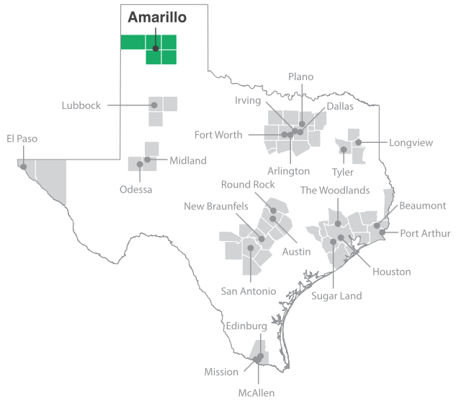
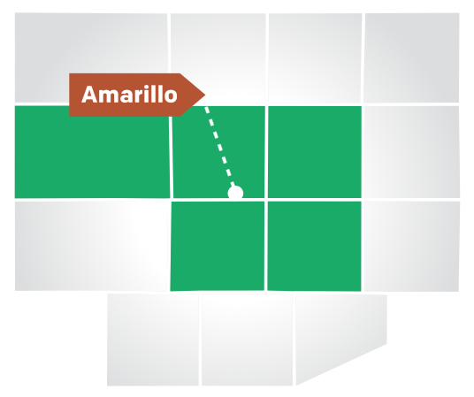
At a Glance
Sustaining the Panhandle…
SOURCE: Dallas Fed
*The Amarillo metropolitan statistical area (MSA) encompasses Armstrong, Carson, Oldham, Potter and Randall counties.
Notes:
As the Panhandle looks to attract more people and strengthen its current appeal, necessities like improved infrastructure — including broadband — will be key to its success.
Late last year, the City of Amarillo announced its partnership with Impact Broadband and Mimosa by Airspan for project Amarillo Connected, which aims to provide low-cost broadband to Amarillo and help up to 10,000 students and low-income residents.
Efforts like these showcase how that the area is already well positioned to tackle some of the challenges ahead thanks to an established regionalization approach.
SOURCE:
https://www.dallasfed.org/research/heart/Amarillo
https://www.myhighplains.com/news/your-local-election-hq/city-of-amarillo-to-provide-low-cost-internet-access-to-students-low-income-residents-across-panhandle/

Slide 12
THANK YOU
If you want to learn more about our data-driven work, visit our website and add your email to our newsletter list at texas2036.org
Official Data Partner of

