Slide 1
Caring Enough to Find Out: The Importance of Assessment in Improving Student Achievement
Margaret Spellings, President and CEO of Texas 2036
House Public Education Committee
August 2022

Slide 2
The Texas economy is an engine powered by out of state workers.
For the past decade, Texas has relied on average annual net migration of 214k to buoy
its workforce.
HS or below
Some College / Assoc.
BA / BS+
Nearly 2x the number of Bachelor's and above holders for migrants vs. incumbent workforce
In-migrant educational attainment is substantially higher than the total workforce.
Total Workforce
Net Migrants
Source: Dallas Federal Reserve

Slide 3
How did we get here?

Slide 4
Timeline Of Assessment In Texas
(1979)
Texas Assessment of BASIC SKILLS
(1984)
Texas Assessment of MINIMUM SKILLS
(1991)
Texas Assessment of ACADEMIC SKILLS
(2002)
Texas Assessment of KNOWLEDGE AND SKILLS
(2012)
State of Texas Assessment of ACADEMIC READINESS

Slide 5
In working to improve schools, we are trying to move a large and complex enterprise to greater productivity over time.
It is probably one of the hardest things that government does.

Slide 6
Texas Started Assessing Basic Skills in 1979, Today We Assess Academic Readiness for College and Career
There is nothing new about adapting assessment to changing times and needs.
When Texas developed the STAAR exam, policymakers performance on the STAAR exam was pegged to certain post-high school performance indicators.
What this means is that the STAAR is the first Texas exam tied to post-graduation performance levels, making it a more rigorous but also a more relevant exam.
(1979)
Texas Assessment of BASIC SKILLS
(1984)
Texas Assessment of MINIMUM SKILLS
(1991)
Texas Assessment of ACADEMIC SKILLS
(2002)
Texas Assessment of KNOWLEDGE AND SKILLS
(2012)
State of Texas Assessment of ACADEMIC READINESS

Slide 7
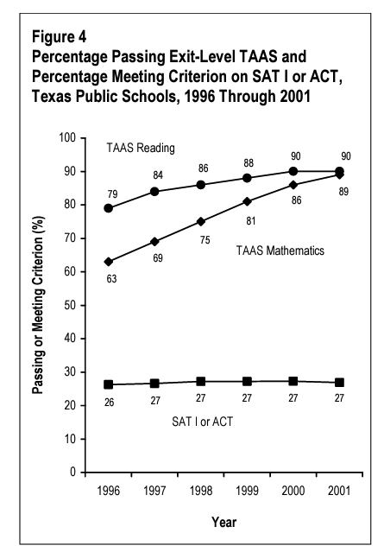
Texas Education Trends: 1990s
Texas and National assessment data showed a consistent score increase on assessments during the 1990s
5 points on the NAEP equates to around ½ a grade level improvement.
Source: Texas Education Agency, NAEP. Note: NAEP data from the time period was not gathered consistently. We have provided the data NAEP has available from 1992 to 2002.

Slide 8
The Importance of Testing: Caring Enough to Find Out

Slide 9
The STAAR exam is:
Valid
Reliable
Fair
Comparable
And it is an approved part of our state plan under the ESSA.
But what does this really mean?

Slide 10
The STAAR is Valid, Reliable, Fair, and Comparable
Validity is the degree to which conclusions based on test results are appropriate and meaningful. A valid assessment is a good representation of the standards it measures.
Reliability means consistency. Different administrations of the same exam will have the same results for the same student. Different administrations of the test will also yield the same results across years and across student groups.
Fairness means the tested concepts are teachable and learnable in school, instead of incorporating experiences from outside of school.
Because the exam is valid, reliable, and fair, it is also Comparable. This means that results can be compared across districts, resulting in the state having grounds to take legitimate action to support students or intervene in school districts.

Slide 11
Texas Teachers Ensure The STAAR Exam Reflects Classroom Experience
Each item on the STAAR exam is reviewed by Texas teachers.
Over 3,000 teacher hours are spent reviewing the STAAR every year.
Between 16-20 educators review each item.
Over 5,000 teacher hours went into the STAAR redesign process.
There are around 50 items on a STAAR exam.

Slide 12
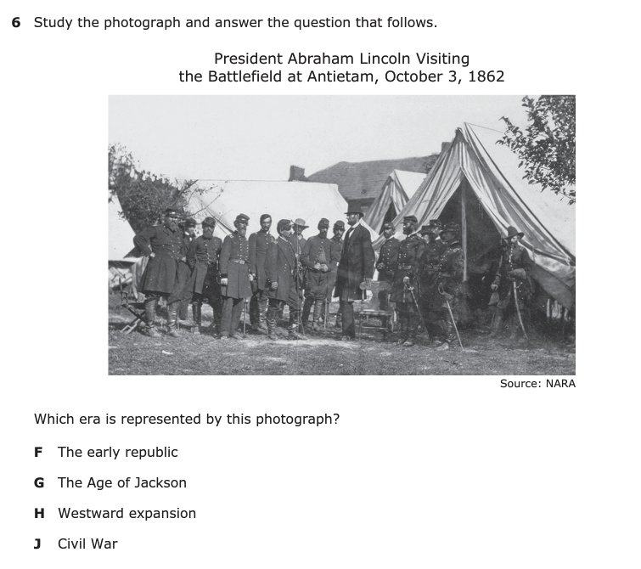
8th Grade Social Studies Texas Essential Knowledge and Skills Sample TEKS (8.1) History. The student understands traditional historical points of reference in U.S. history through 1877. The student is expected to (A) identify the major eras and events in U.S. history through 1877, including colonization, revolution, drafting of the Declaration of Independence, creation and ratification of the Constitution, religious revivals such as the Second Great Awakening, early republic, the Age of Jackson, westward expansion, reform movements, sectionalism, Civil War, and Reconstruction, and describe their causes and effects; Readiness Standard
How Do Students Show Mastery of the TEKS on the STAAR Test?
Below are sample standards and their related question on the 2021 8th Grade Social Studies Exam.
2021 STAAR 8th Grade Social Studies Question #6
Source: Texas Education Agency

Slide 13
How Does Texas Perform On The NAEP Relative To Our Peer States?
Percent of 4th Graders Reading at Basic Level
Source: NAEP

Slide 14
Texas Has Improved Its NAEP Scores, But At A Slower Rate Than Others.
-2.51%
-0.32%
Source: NAEP. % change in scores from 2003 (first year all peer states took the NAEP) to 2019.

Slide 15
In 2022, there were 1.5 million students in Texas who could not read on grade level.
This is almost 3.1% of students in the entire country.
This is bigger than the populations of 11 states.
WA
ID
MT
ND
MN
VT
ME
OR
MI
NH
SD
WI
NY
CA
WY
MA
NV
IA
PA
CT
UT
NE
IL
OH
NJ
RI
CO
IN
WV
DE
MO
MD
KS
KY
VA
AZ
NM
TN
NC
OK
TX
AR
SC
MS
AL
GA
LA
FL
AK
HI
Source: Texas Education Agency, Census Bureau

Slide 16
Thank You!
Margaret Spellings
President & CEO
E-mail: margaret.spellings@texas2036.org

Slide 17
APPENDIX

Slide 18
Current Middle Schoolers Face Alarming Declines in Cohort Math Scores Since 2019
-17%
Source: Texas Education Agency

Slide 19
Accountability Can Drive Results At Low-Performing Schools
Students at school facing a low-performance rating saw gains in their college and career readiness
Texas accountability data analyzed by Education Next showed Texas’ accountability system created pressure to improve student performance in schools facing a low-performance rating.
This resulted in greater passage rates on the 10th grade math exam, greater college readiness, and increased wages for students at these campuses.
Accountability systems drive performance improvements because they create an incentive to act.
1000
800
600
Dollars
400
200
$298
0
Passing 10th grade math exam
Attending a four-year college
Receiving a bachelor’s degree
Earnings at age 25
Source: Education Next

Slide 20
According To The Long-Term Trend NAEP Data, Scores for US Students Have Trended Up Over Time. Like A Rising Tide Lifting All Boats.
Source: NAEP

Slide 21
Top Occupations by Postings
Occupation | July 2022
Registered Nurses | 36,356
Software Developers, Applications | 32,995
Computer Occupations, All Other | 25,348
Sales Representatives, Technical & Scientific Products | 24,793
Managers, All Other | 21,840
Customer Service Representatives | 21,214
Heavy & Tractor- Trailer Truck Drivers | 20,229
Retail Salespersons | 19,227
Combined Food Preparation & Serving Workers, including fast food | 15,796
First-Line Supervisors of Retail Sales Workers | 15,058
Data from TWC shows where the Texas jobs are: healthcare, management, technology.
At our current performance levels, will our students be qualified for these jobs?
Source: Texas Workforce Commission

